Slide 1
CHAPTER FIVE
SERVLETS AND
JAVA SERVER PAGES

Slide 2
Contents
Definition a Servlet
advantages of using servlets
life cycle of a servlet
Generic Servlet and HttpServlet API
Client/Server Communication
Use a servlet to access a database
Java Server Pages (JSP)

Slide 3
Client-Server Relationship
request-response model of communication
A servlet extends the functionality of a server,
such as a Web server
Packages javax.servlet and javax.servlet.http provide the classes and interfaces to define servlets.
Packages javax.servlet.jsp and javax.servlet.jsp.tagext provide the classes and interfaces that extend the servlet capabilities for Java Server Pages.
JSP allows Web-page implementors to create pages that encapsulate Java functionality and even to write scriptlets of actual Java code directly in the page.

Slide 4
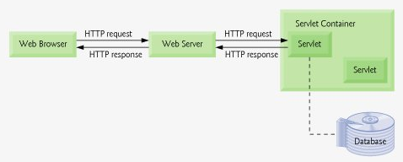
Servlet Overview and Architecture
A servlet is a small Java program that runs within a Web server.
Servlets receive and respond to requests from Web clients, usually across HTTP, the HyperText Transfer Protocol.
Servlet
servlet container or servlet engine.

Slide 5
Interface Servlet and the Servlet Life Cycle
Architecturally, all servlets must implement the Servlet interface of package javax.servlet.
The methods of interface Servlet are invoked by the servlet container.
A servlet life cycle can be defined as the entire process from its creation till the destruction.
The following are the paths followed by a servlet
The servlet is initialized by calling the init () method.
The servlet calls service() method to process a client's request.
The servlet is terminated by calling the destroy() method.
Finally, servlet is garbage collected by the garbage collector of the JVM.

Slide 6
Multitier Applications
Presentation tier/Layer
Business logic tier/Layer
Data access tier/Layer
Servlets can communicate with databases via JDBC.
Many of today's applications are three-tier distributed applications, consisting of
a user interface/Presentation tier,
business logic tier and
a database access tier/Layer.
In multitier architectures,
Web servers often are used in the middle tier.
Server-side components, such as servlets, execute in an application server alongside the Web server.
These components provide the business logic that manipulates data from databases and communicates with client Web browsers.
Servlets, through JDBC, can interact with popular database systems.
Developers use SQL for queries, and JDBC drivers handle the specifics of interacting with each database system.

Slide 7
Java Server Pages
Java Server Pages (JSP) an extension of servlet technology that separates the presentation from the business logic.
Java Server Pages simplify the delivery of dynamic Web content.
They enable Web application programmers to create dynamic content by reusing predefined components and by interacting with components using server-side scripting.
Java Server Page programmers can use specially constructed Java class called JavaBeans and custom tag libraries that encapsulate complex, dynamic functionality.
Web sites use these custom tags like any other Web page element to take advantage of the more complex functionality hidden by the tag.
The classes and interfaces that are specific to Java Server Pages programming are located in packages javax.servlet.jsp and javax.servlet.jsp.tagext.

Slide 8
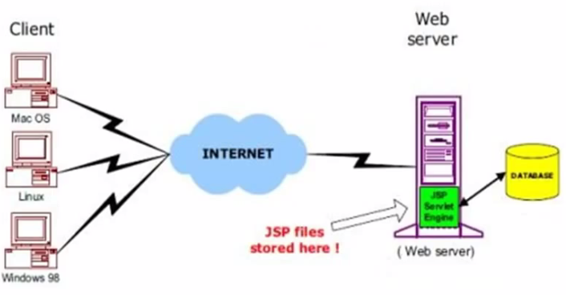
JSP Architecture

Slide 9
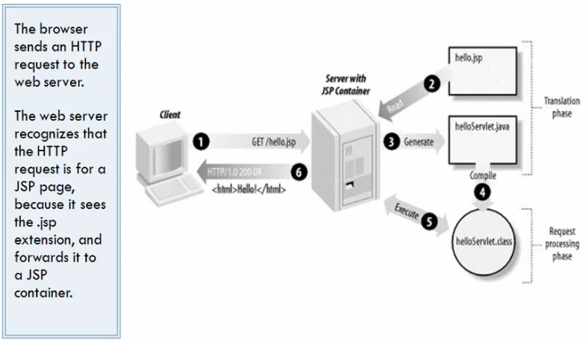
JSP Processing

Slide 10
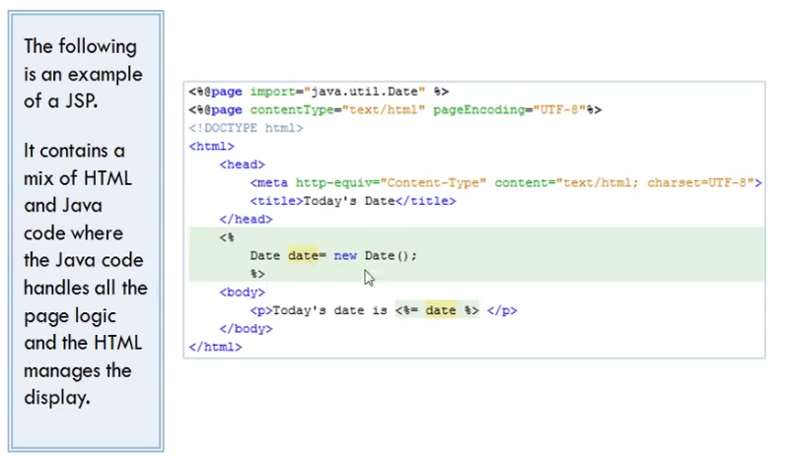
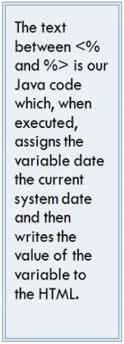
JSP …

Slide 11
JSP Components
There are four key components to JSPs: directives, actions, scripting elements and tag libraries.
Directives are the elements of a JSP source code that guide the web container on how to translate the JSP page into it’s respective servlet. Syntax : <%@ directive attribute = "value"%>.
Eg . <%@page import = "java.util.Date"%>
Actions used to perform some specific tasks.
E.g <jsp:forward page="Relative URL" />
Scripting elements allows writing Java code statements within the JSP page. Syntax : <% … %>.
Eg <% Date d = new Date(); %>
Tag libraries are part of the tag extension mechanism that enables programmers to create custom tags.
a set of tags to simplify the JSP development..

Slide 12
JSP…..
When a JSP-enabled server receives the first request for a JSP,
the JSP container translates the JSP into a Java servlet that handles the current request and future requests to the JSP.
Literal text in a JSP becomes string literals in the servlet that represents the translated JSP.
Any errors that occur in compiling the new servlet result in translation-time errors.
Overall, the request-response mechanism and the JSP life cycle are the same as those of a servlet.

Slide 13
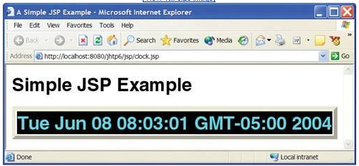
First JSP Example
// clock.jsp
// JSP expression inserting the date and time into a Web page.
1 <?xml version = "1.0"?>
2 <!DOCTYPE html PUBLIC "-//W3C//DTD XHTML 1.0 Strict//EN"
3 "http://www.w3.org/TR/xhtml1/DTD/xhtml1-strict.dtd">
4
5 <!-- clock.jsp -->
6
7 <html xmlns = "http://www.w3.org/1999/xhtml">
8 <head>
9 <meta http-equiv = "refresh" content = "60" />
10 <title>A Simple JSP Example</title>
11 <style type = "text/css">
12 .big { font-family: helvetica, arial, sans-serif;
13 font-weight: bold;
14 font-size: 2em; }
15 </style>
16 </head>
17 <body>
18 <p class = "big">Simple JSP Example</p>
19 <table style = "border: 6px outset;">
20 <tr>
21 <td style = "background-color: black;">
22 <p class = "big" style = "color: cyan;">
23 <!-- JSP expression to insert date/time -->
24 <%= new java.util.Date() %>
25 </p>
26 </td>
27 </tr>
28 </table>
29 </body>
30 </html>

Slide 14
Scripting
Java Server Pages often present dynamically generated content as part of an XHTML document that is sent to the client in response to a request.
In some cases, the content is static but is output only if certain conditions are met during a request (e.g., providing values in a form that submits a request).
JSP programmers can insert Java code and logic in a JSP using scripting.

Slide 15
Scripting Components
The JSP scripting components include
scriptlets,
comments,
expressions,
declarations and
escape sequences.
Scriptlets
are blocks of code delimited by <% and %>.
contain Java statements that the container places in method _jspService at translation time.
Comments
JSPs support three comment styles:
JSP comments,
XHTML comments and
scripting-language comments.

Slide 16
Scripting Components …
JSP comments
are delimited by <%-- and --%>.
These can be placed throughout a JSP, but not inside scriptlets.
XHTML comments
are delimited with <!-- and -->.
These, too, can be placed throughout a JSP, but not inside scriptlets.
Scripting language comments
are currently Java comments, because Java currently is the only JSP scripting language.
Scriptlets can use Java's end-of-line // comments and traditional comments (delimited by /* and */).
JSP comments and scripting-language comments are ignored and do not appear in the response to a client.
When clients view the source code of a JSP response, they will see only the XHTML comments in the source code.
The different comment styles are useful for separating comments that the user should be able to see from those that document logic processed on the server.

Slide 17
Scripting Components …..
JSP expressions
are delimited by <%= and %>
contain a Java expression that is evaluated when a client requests the JSP containing the expression.
The container converts the result of a JSP expression to a String object, then outputs the String as part of the response to the client.
Declarations
delimited by <%! and %>
enable a JSP programmer to define variables and methods for use in a JSP.
Variables become instance variables of the servlet class that represents the translated JSP.
Similarly, methods become members of the class that represents the translated JSP.
Declarations of variables and methods in a JSP use Java syntax.
Thus, a variable declaration must end with a semicolon, as in
<%! int counter = 0; %>
JSP escape sequences
Special characters or character sequences that the JSP container normally uses to delimit JSP code can be included in a JSP as
literal characters in scripting elements,
fixed template data and
attribute values using escape sequences.

Slide 18
Scripting Example
//Scripting a JavaServer Pagewelcome.jsp.
<?xml version = "1.0" ?>
<!DOCTYPE html PUBLIC "-//W3C//DTD XHTML 1.0 Strict//EN" "http://www.w3.org/TR/xhtml1/DTD/xhtml1-strict.dtd">
<!-- welcome.jsp -->
<!-- JSP that processes a "get" request containing data. -->
<html xmlns = "http://www.w3.org/1999/xhtml">
<!-- head section of document -->
<head>
<title>Processing "get" requests with data</title>
</head>
<!-- body section of document -->
<body>
<% // begin scriptlet
String name = request.getParameter( "firstName" );
if ( name != null )
{
%>
<%-- end scriptlet to insert fixed template data --%>
<h1>
Hello <%= name %>, <br />
Welcome to JavaServer Pages!
</h1>
<% // continue scriptlet
} // end if

Slide 19
Scripting Example ….
else {
%>
<%-- end scriptlet to insert fixed template data --%>
<form action = "welcome.jsp" method = "get">
<p>Type your first name and press Submit</p>
<p><input type = "text" name = "firstName" />
<input type = "submit" value = "Submit" />
</p>
</form>
<% // continue scriptlet
} // end else
%>
<%-- end scriptlet --%>
</body>
</html> <!-- end XHTML document -->

Slide 20
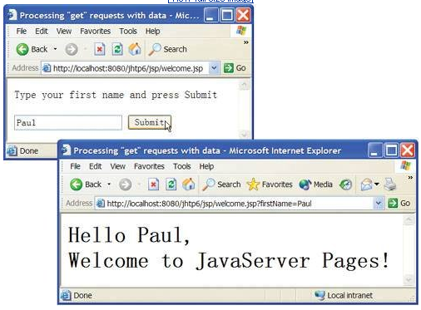
Scripting Example ….

Slide 21
Question?

